Slide 1
Establishing a Virtual Classroom
Alote Jones
11/13/2022

Slide 2
Abstract
Education has seen considerable technological developments in the recent several decades, including computer-aided learning, which promises to dramatically alter the ways of teaching and learning. The Internet has played a significant role in the storing and diffusion of information in the educational sector. Traditional classroom-based education entails the speaker delivering course materials in a certain location at a specific time. As a result, both the teacher and the learner are constrained in terms of time and location. Because of the human aspect inherent in the conventional classroom technique, the professor might not always be able to exert maximum effort in planning and coordinating course contents.

Slide 3
Intro
The benefits of establishing a virtual classroom.
Flexibility
Reduced cost
More Free time
Enhanced Time Management
Immediate feedback

Slide 4
Method
The research method I will choose is a focus group. I will gather a small number of individuals to discuss things in a controlled environment about the benefits of establishing a virtual classroom. I selected this method because I want genuine, uncensored comments to the issue at hand. The questions on the subject are based on thoughts or experiences and therefore cannot be quickly answered with yeah or no.

Slide 5
Flexibility
Lectures will be scheduled at a specific time of day and your schedule will be formed around the availability of classes.
For example, if a student has to watch their siblings throughout the day he could prosper in the class by working longer at night.
If you’re currently employed and courses aren’t available after your working hours, it can be difficult to juggle a course load in addition to your work duties.
Having more control over your schedule also means you can avoid distractions easier.
Online study gives you significantly more freedom in determining your own schedule. Which implies you can study anytime it suits you.
A teacher, for example, may offer assignments online on Sundays so that students may work at their own speed during the week.

Slide 6
Flexibility Examples
For example, if a student has to watch their siblings throughout the day he could prosper in the class by working longer at night.
A teacher, for example, may offer assignments online on Sundays so that students may work at their own speed during the week.

Slide 7
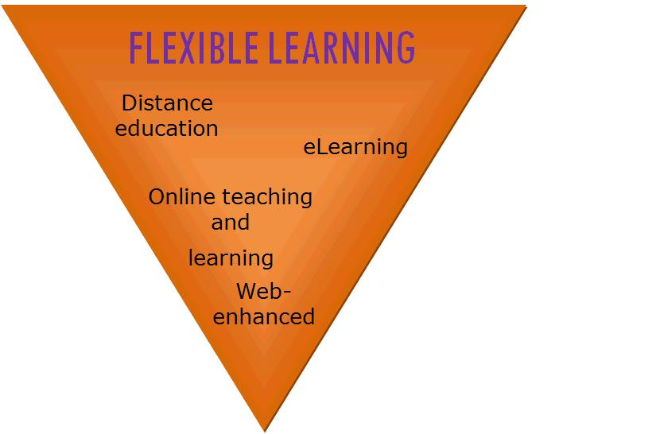
Graph
Management of responsibilities.
Career/Job
Bill Paying
House chores
Children…if any
Can Learn in any environment you choose.
Gym
Coffee shop
Library
Respects students who love routines. Such as working out, practices , or etc.. as long as it isn’t harmful.

Slide 8
Reduce Cost
Education can be costly, but virtual learning can help students save money in a variety of ways. Students can save money on commuting by not having to drive to school.
The typical student spends over $1,000 annually on textbooks and course content. Because virtual resources are frequently used in courses, less money is spent on textbooks.
Instructional strategies are maintained online in a single database where they are immediately available for download, allowing for quick updates to accommodate any changes.
Room and board fees average around 8,000 to 10,000 a year for off campus and on campus students.

Slide 9
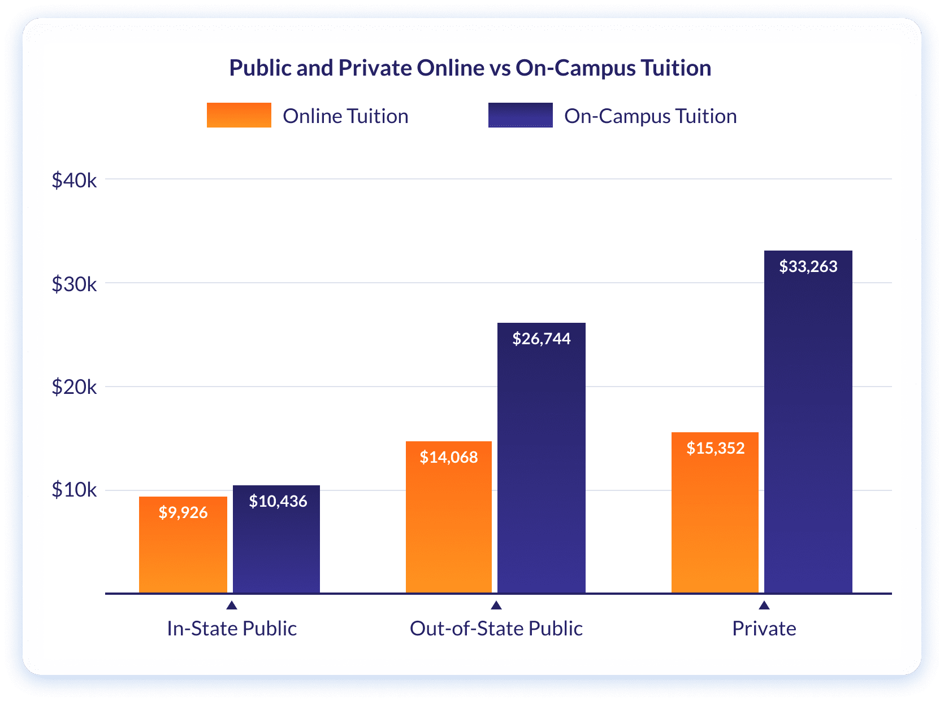
Chart

Slide 10
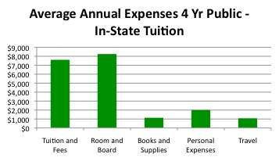
Chart

Slide 11
More Free Time
Because your schedule isn’t dictated by classes, you can spend more time doing the things you want.
Traveling to different places
Learn how to start your own company/brand
Shopping
Not having to commute also means saving time because you don’t need to travel to-and-from campus.
This has a part to play in my next subtopic reduced cost.
All you need is a digital device and an internet connection, and you have access to the necessary tools to further your education and earn your degree on your own time.
Smartphone
Tablet
computer

Slide 12
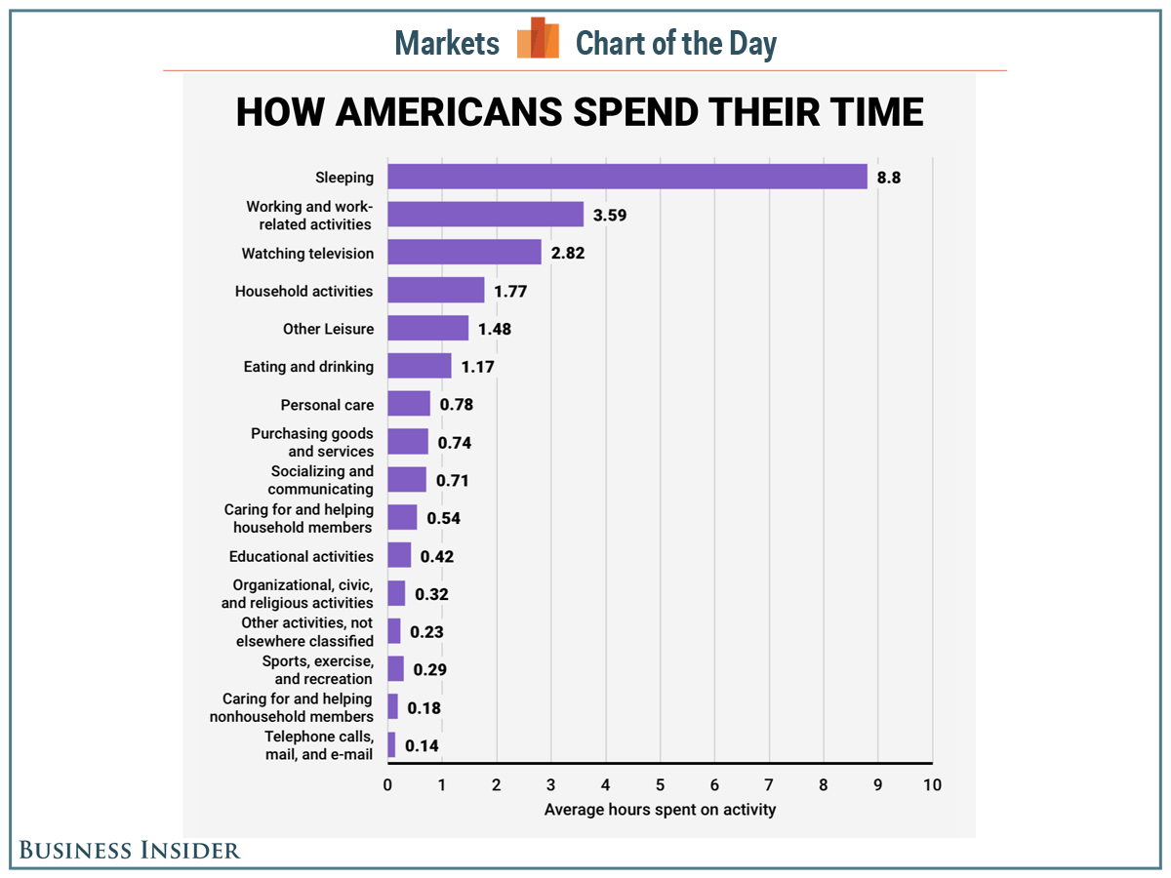
Chart

Slide 13
Establishing a Virtual Classroom during Covid 19 Pandemic
Many instructors were compelled to reconsider how to keep kids interested throughout the covid pandemic. Because many school districts shared virtual curriculum during the remote learning time, older students may take more rigorous or intriguing courses than they could in person, according to Rossen.
The same may be said for younger students: Megan Hibbard, a fifth-grade teacher in White Bear Lake, Minnesota, said many of her students preferred internet learning over in-person learning because they could work on projects that matched their interests.

Slide 14

Major virtual classroom

Slide 15
Zoom Facts
In 2020, people downloaded the video meeting platform about 485 million times.
Zoom hosted a bit over 3.3 trillion annual minutes in 2020.
In 2020, there were around 350 million daily active participants.
36.59% of all Zoom users are from the US.

Slide 16
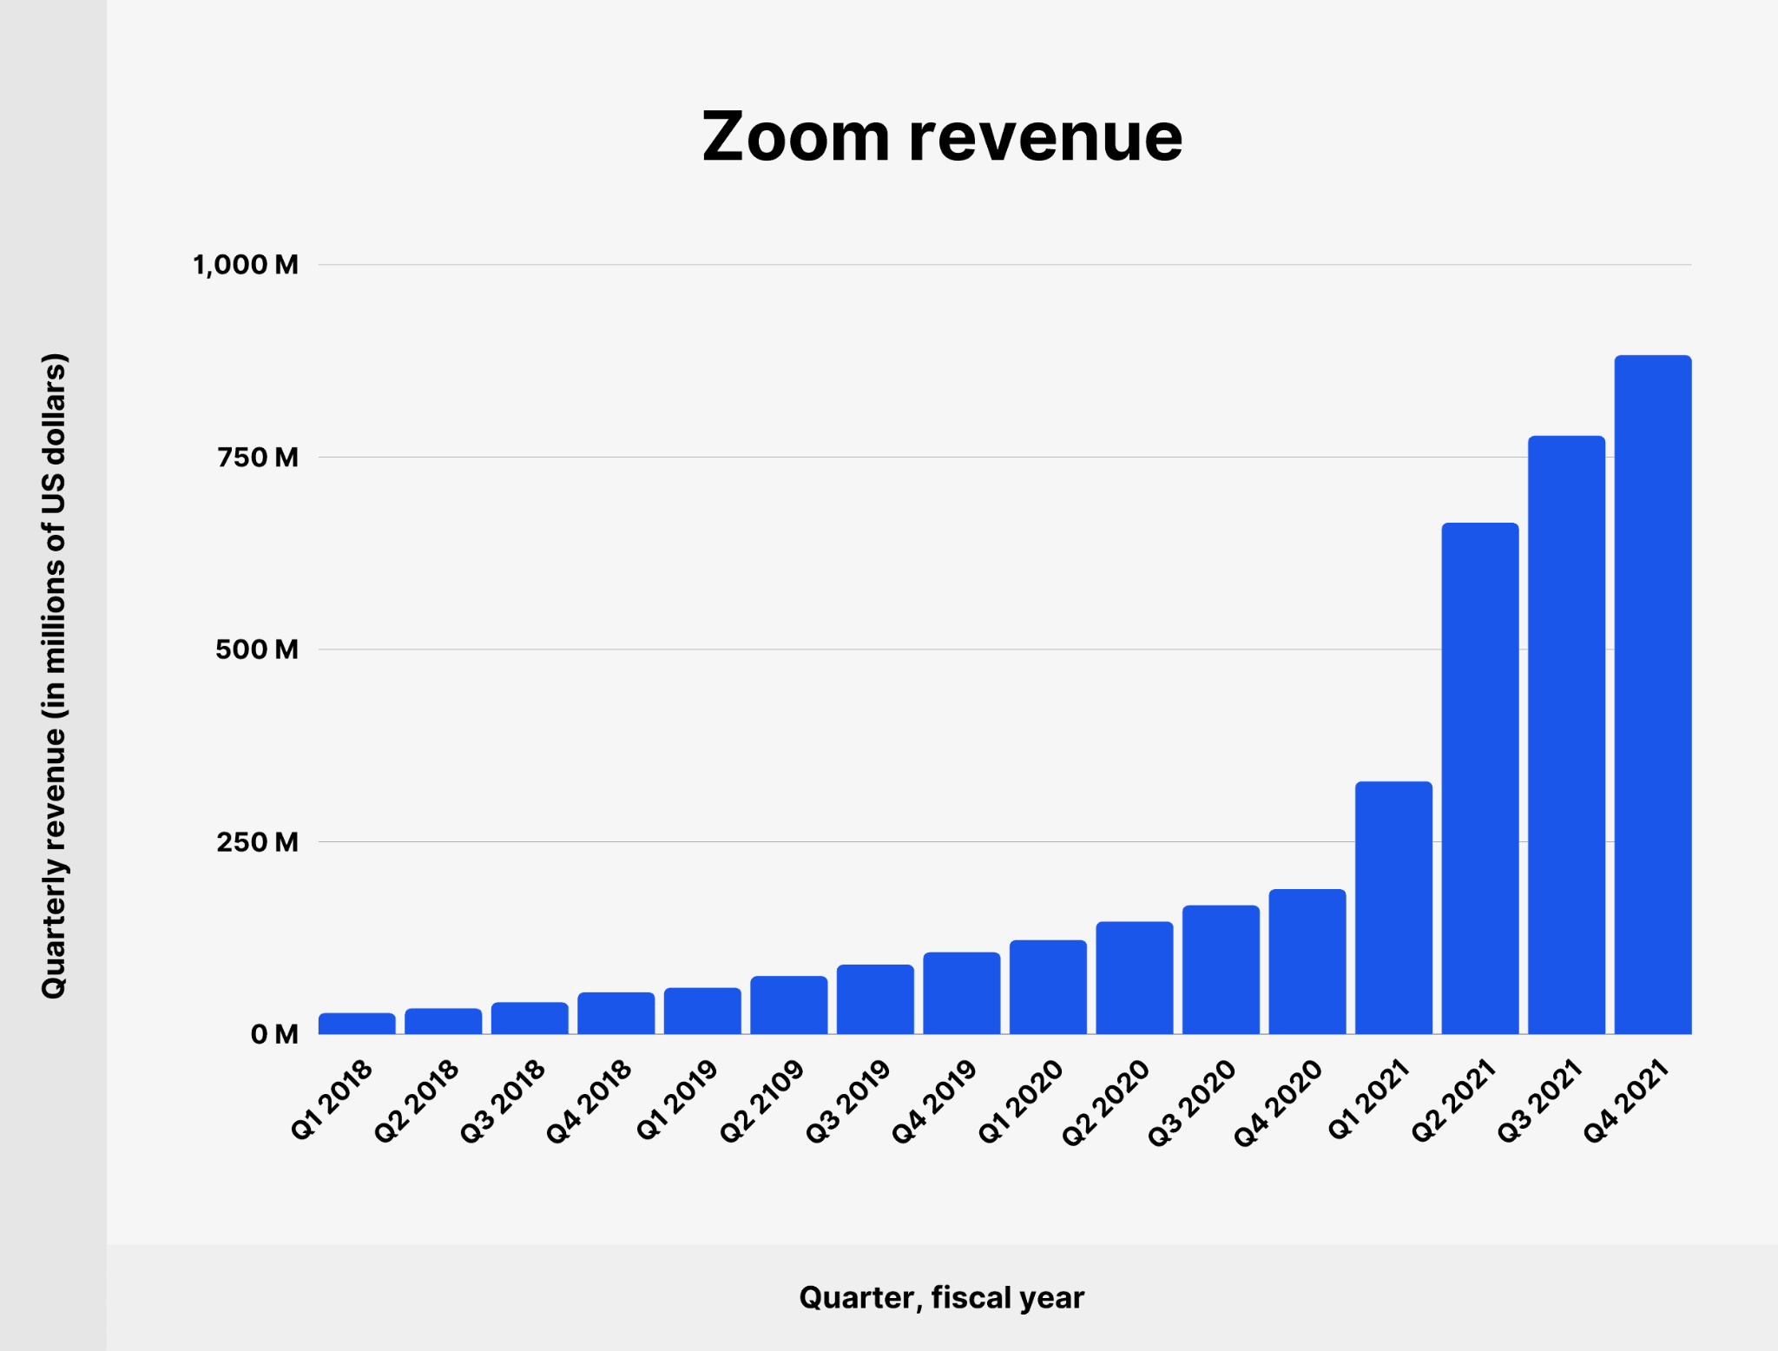
Zoom Revenue

Slide 17
Reasons to Establish a Virtual Classroom
Stephen Becker, PhD, a pediatric psychologist at Cincinnati Children’s Hospital Medical Center, said some parents have observed their children’s behavior or learning needs for the first time, which could prompt them to consider assessment and Individualized Education Program (IEP) services. Across the board, Gehlbach said parents are realizing how they can better partner with schools to ensure their kids’ well-being and academic success.

Slide 18


Slide 19
Reasons to Establish a Virtual Classroom
Scott Graves, PhD, an associate professor of educational studies at The Ohio State University and a member of APA’s Coalition for Psychology in Schools and Education, said the supervision by parents and teachers in remote learning likely played a part in reducing bullying. As a result, he’s less worried his Black sons will be victims of microaggressions and racist behavior during online learning.

Slide 20
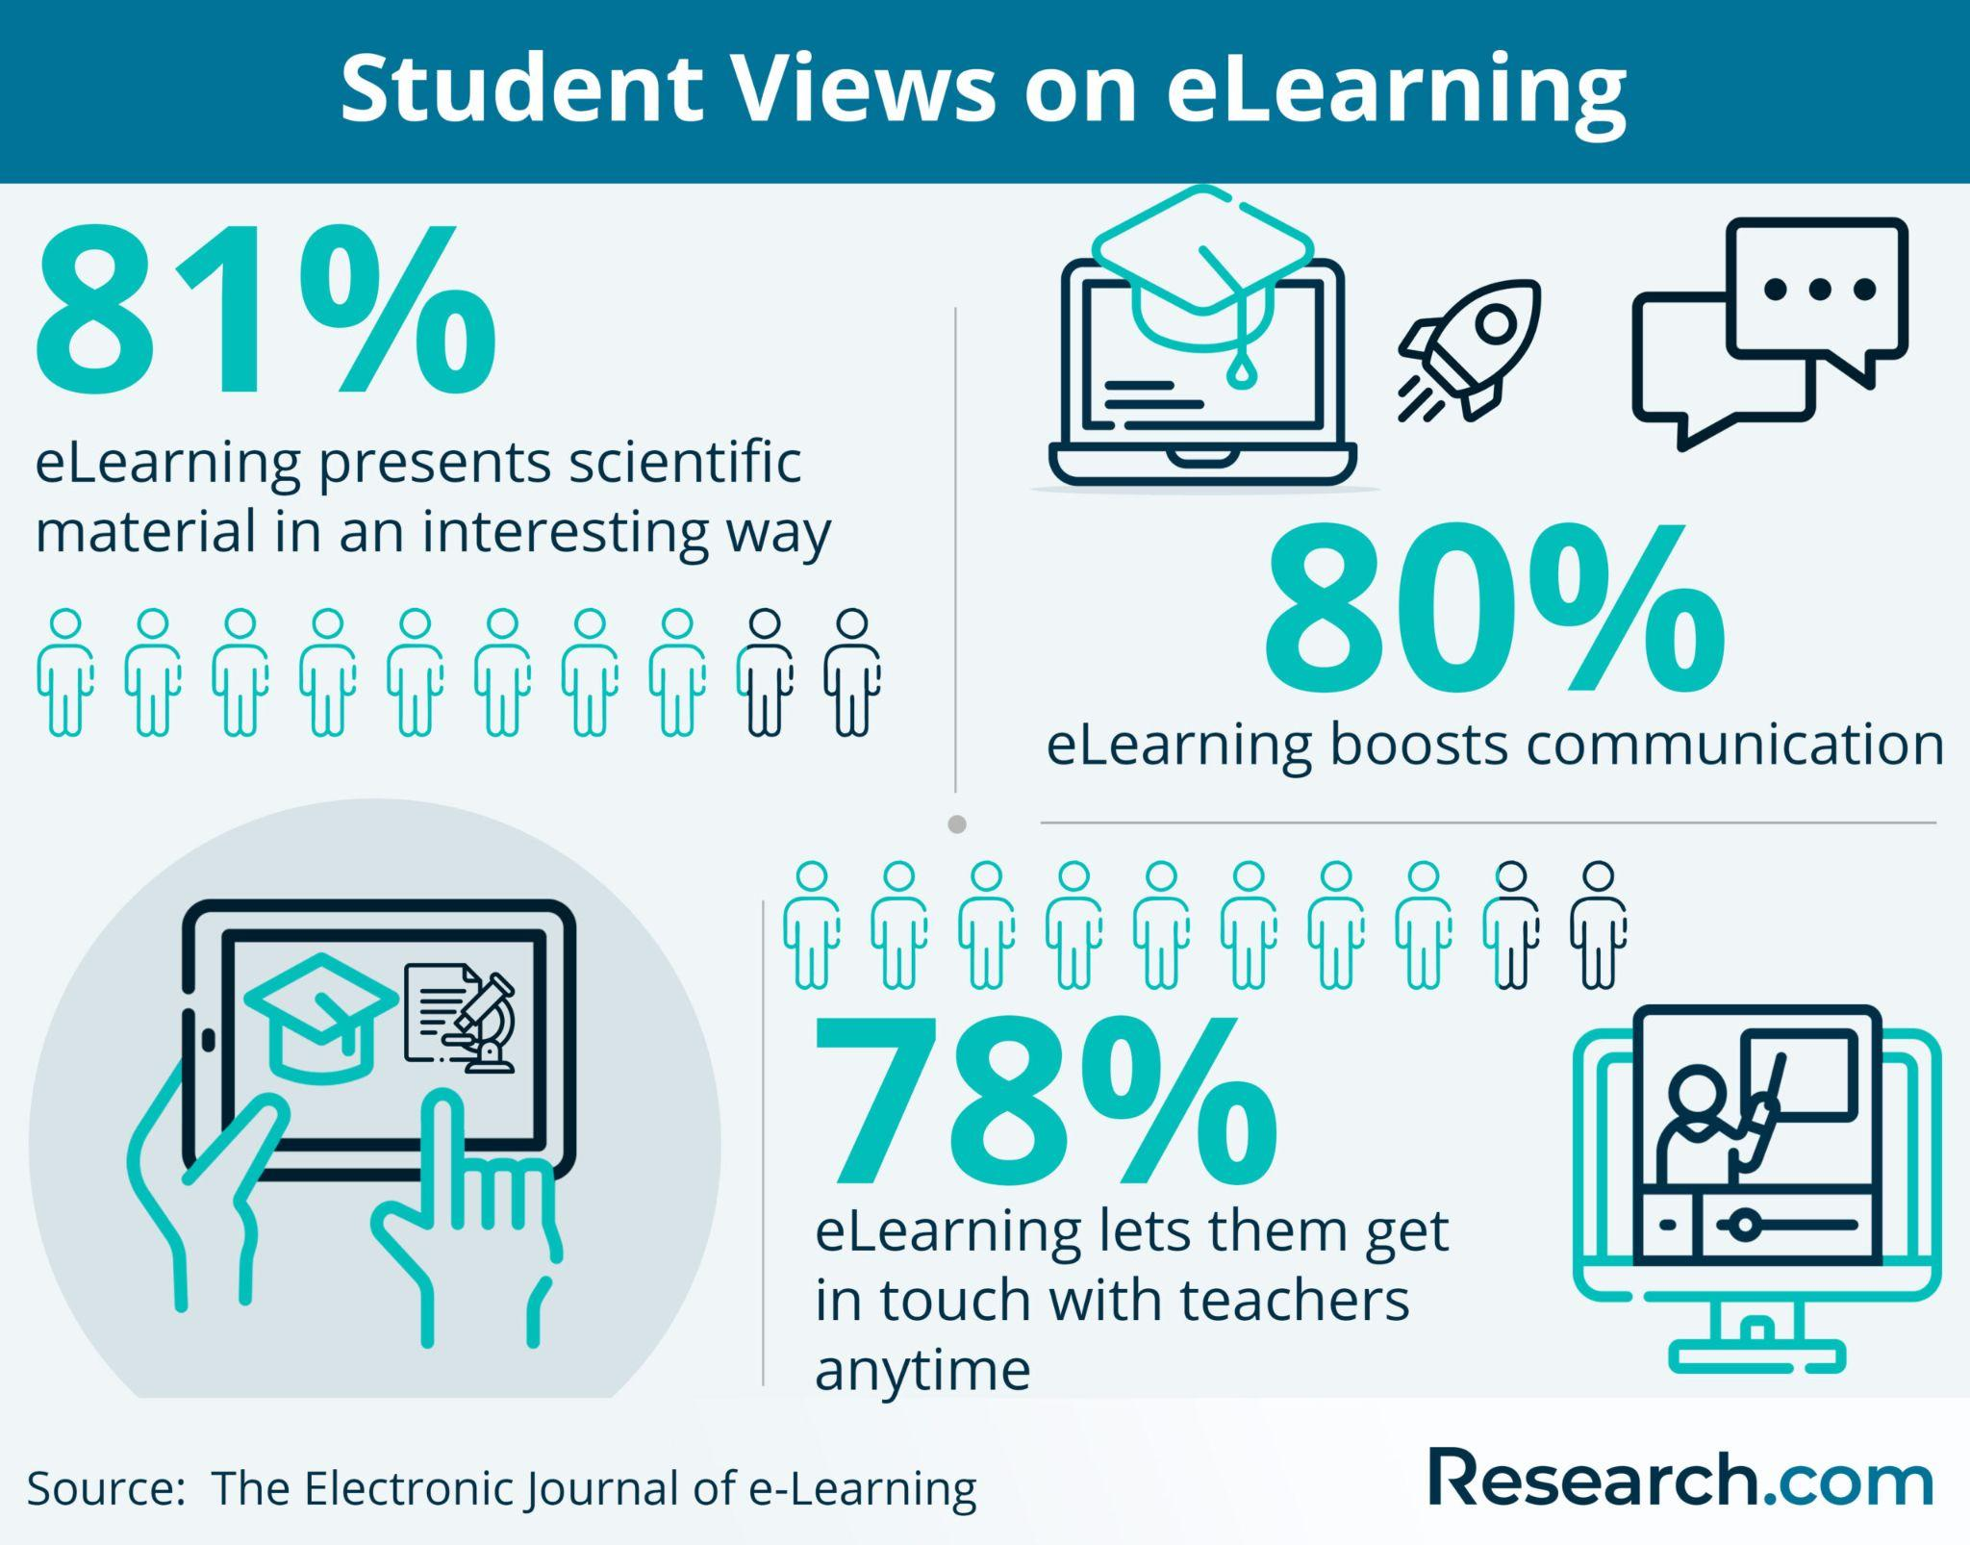

Slide 21
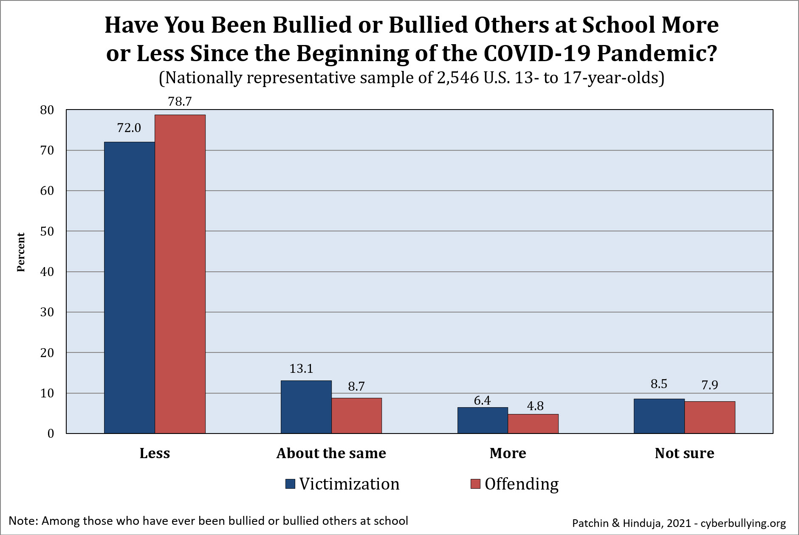
Bullying graph from remote learning after the pandemic

Slide 22

Enhanced time management
Students need to manage their time wisely to ensure they complete their assignments by the deadlines set by the professor.
Deadlines enable us to cooperate toward a common objective and keep complicated, multilevel projects on track.
To establish expectations.
Deadlines specify what and when we are expected to deliver.
This implies that we take charge of our task without being confused.

Slide 23
Immediate feedback
Immediate feedback is when information is delivered contextually and on-demand, it is in direct reaction to a learner's behavior and in the flow of learning.
Instead of waiting days or weeks following examinations, you may frequently obtain rapid feedback.
Allows you to address a problem straight away
You can quickly see where you did well and where you need improvement.

Slide 24
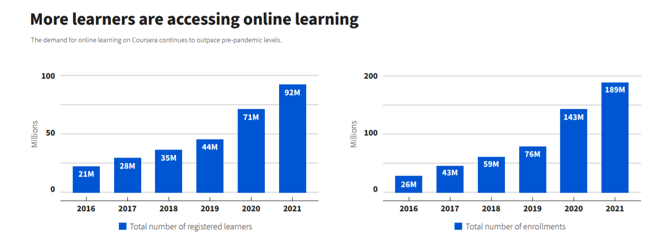
Chart showing students signing up for virtual classroom

Slide 25
Results
If you want to enroll in an online program, you should be aware that these virtual courses demand more self-motivation and self-discipline. You must be self-motivated because your lecturers will not intervene or push you to complete your daily class on time. Every day, you must discover efficient strategies to keep the drive alive. As a result, you must be a self-directed learner. This internal transformation, however, takes time to occur, which is completely natural. All you need to do is be willing to change.

Slide 26
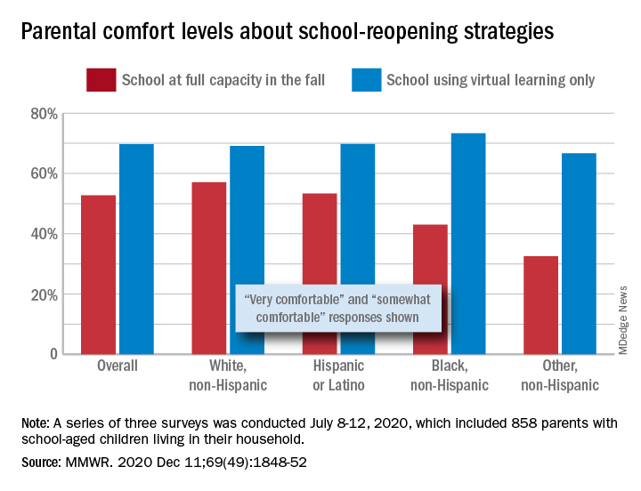
Chart showing parental comfort levels

Slide 27
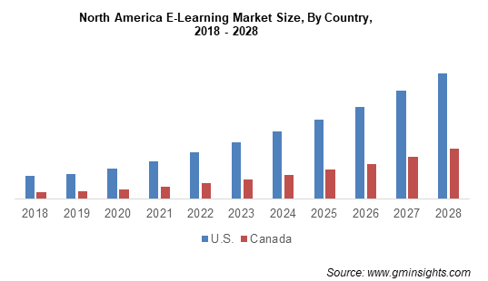
Chart showing virtual learning increases

Slide 28
Conclusion
In conclusion, both students and educators benefit greatly from online learning. Students can readily locate textbooks and school resources, as well as employ multimedia to make their learning experience more enjoyable and appealing. Instructors, on the other hand, may distribute assignments and reading materials with a single click utilizing various online platforms that are specifically created to make the teaching and learning process easier and more enjoyable.

Slide 29
References
https://edtechmagazine.com/k12/article/2020/08/how-set-virtual-classroom
https://www.edutopia.org/article/creating-inclusive-virtual-classroom
https://elearningindustry.com/virtual-classroom-why-future-online-learning
https://www.apa.org/monitor/2021/09/cover-remote-learning

Slide 30

Discussion

